Slide 1
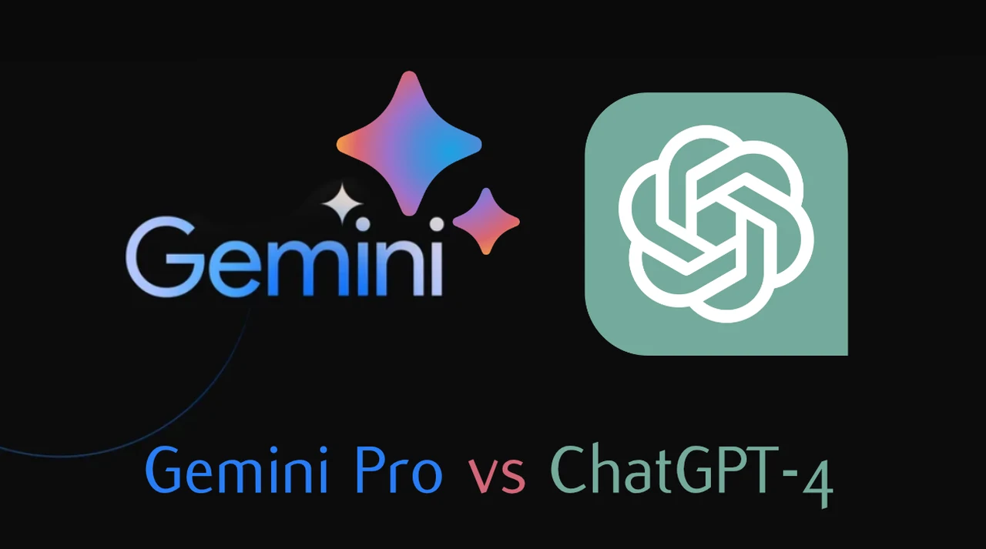
Conversational Contest
ChatGPT vs Gemini AI
GROUP 6
1226847 Sree Krishna, Chandana
1221643 Swain, Gurdeep
1219988 Tabrez, Shams
1210987 Tayo, Adeoye
1228363 Thakkar, Bhargav Hemantkumar
1094117 Vyas, Dron Sushrutkumar
1218119 Warnakulasuriya, Nimasha
1229740 Divyam, Patel
​Supervised by Dr. Sabah Mohammed

Slide 2
Introduction
The Internet of Things (IoT) landscape is marked by its complexity, presenting a significant hurdle for many individuals seeking to grasp its intricacies.
Addressing this challenge, Conversational AI emerges as a promising solution, offering interactive platforms capable of simplifying complex concepts and providing tailored guidance.
This experiment aims to evaluate the effectiveness of two widely used large language models (LLMs), namely ChatGPT-4 and Gemini Pro, in engaging in meaningful dialogue with users and offering thoughtful answers to their inquiries regarding IoT models.
With IoT being a longstanding domain, users have accumulated numerous questions that demand clarification. However, the abundance of available resources often overwhelms users and hampers their productivity.
Through this experiment, we endeavor to streamline the understanding of IoT by harnessing the capabilities of Conversational AI, ultimately facilitating informed decision-making and fostering broader adoption of IoT technologies.

Slide 3
Problem
Imbalance in IoT Resources
Limited Understanding
Dependency on Data
Lack of adequate resources for experienced users, leading to a knowledge gap.
While generative models provide assistance in learning, they may not fully understand concepts beyond statistical patterns in the data.
The quality and quantity of data significantly impact the performance of generative models. Insufficient or irrelevant data can lead to poor learning outcomes.

Slide 4
Solution
Use pre-trained Large Language Models (LLMs) for conversational interactions in IoT.
Recognize IoT learning complexity beyond basic Q&A.
Assess model performance in interpreting images within conversations.
Evaluate model handling of user distractions while maintaining coherence.
Consider extensions like voice translation for natural interactions, possibly integrating speech-to-text APIs.

Slide 5
Architecture
Architecture
ChatGPT 4.0
Gemini Pro
Gemini Pro
The GPT-4 builds upon the Transformer architecture's legacy, renowned for its excellence in natural language processing (NLP). Operating on autoregressive language modeling principles, it predicts subsequent tokens in a sequence based on contextual cues. GPT-4's architecture comprises stacked Transformer decoder layers, refining representations iteratively with attention mechanisms focusing on token importance. While its primary strength lies in generating coherent and contextually relevant text responses, GPT-4 also exhibits enhanced capabilities, potentially extending to tasks involving image processing.
Gemini Pro represents the apex of multimodal AI.
It leverages an advanced Mixture of Experts (MoE) architecture.
Designed explicitly for multimodal tasks, it seamlessly integrates text, images, and other modalities.
Gemini Pro harnesses expert networks specialized in diverse data types.
Dynamic routing channels input data to relevant experts, ensuring adaptive processing.
Its scalability and efficiency are enhanced by MoE's advantages.
Gemini Pro can handle complex tasks across various domains with computational finesse.
Gemini Pro represents the apex of multimodal AI, leveraging an advanced Mixture of Experts (MoE) architecture. Designed explicitly for multimodal tasks, it seamlessly integrates text, images, and other modalities, harnessing expert networks specialized in diverse data types. Dynamic routing channels input data to relevant experts, ensuring adaptive processing for superior performance. Gemini Pro's scalability and efficiency are enhanced by MoE's advantages, enabling it to handle complex tasks across various domains with computational finesse.

Slide 6
Architecture
ChatGPT 4.0
The GPT-4 builds upon the Transformer architecture's legacy in NLP.
It operates on autoregressive language modeling principles.
GPT-4 predicts subsequent tokens in a sequence based on contextual cues.
Its architecture consists of stacked Transformer decoder layers.
It refines representations iteratively with attention mechanisms focusing on token importance.
GPT-4's primary strength lies in generating coherent and contextually relevant text responses.
It also exhibits enhanced capabilities that may extend to tasks involving image processing.

Slide 7
Feature | Gemini | ChatGPT
Developer | Google AI | OpenAI
Model Type | Multimodal Language Model (can handle text, images, and potentially other modalities) | Generative Pre-trained Transformer (GPT) Language Model
Base Architecture | Believed to be a Transformer-based architecture | Transformer-based architecture
Training Data | Massive, proprietary dataset curated by Google. Likely combines text, code, and potentially other forms of data. | A massive dataset of text and code with careful filtering to optimize for conversational quality and safety.
Key Strengths | Advanced language understanding. Multimodal capabilities give potential for broader uses. Variation in models allows tailoring to specific needs. | Exceptional conversational ability. Generates diverse and creative text formats. Good at following instructions and staying on topic.
Known Weaknesses | More details are relatively limited as access is not widespread yet. May have similar biases and potential for generating misinformation as found in other large language models. | Struggles with some areas of logic and reasoning. Can be 'jailbroken' with clever prompts to produce undesirable outputs.

Slide 8
Chatbot Settings
ChatGPT 4.0
Gemini Pro
Mechanisms: Custom Safety Net, Intelligent questions, Manual analysis
Interaction: Images, Chat
Context: Internet of Things
Platform: Web Application
Mechanisms: Custom Safety Net, Intelligent questions, Manual analysis
Interaction: Images, Chat
Context: Internet of Things
Platform: Web Application

Slide 9
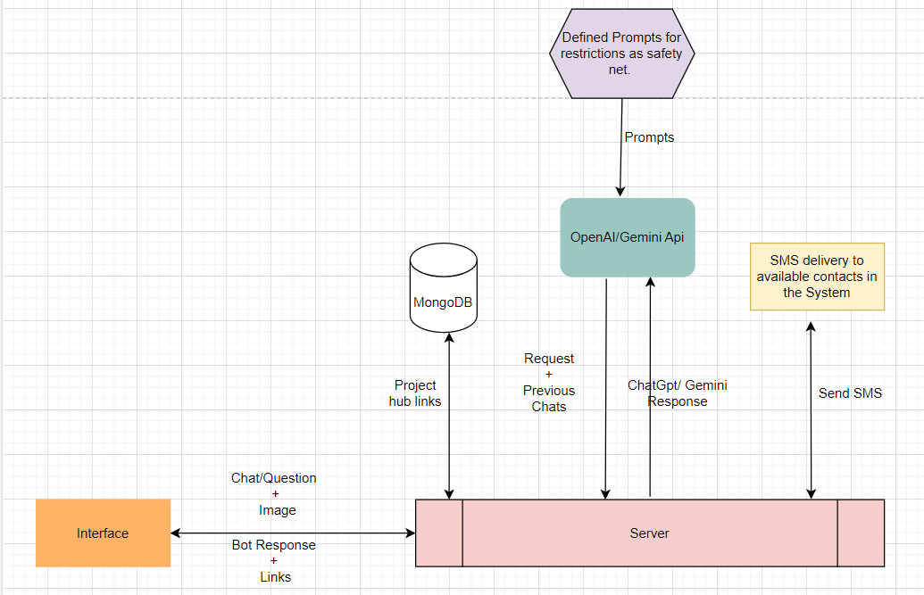
Data Flow
Notes:
Nimasha

Slide 10
Implementation

Slide 11
IOT-related Chatbot Features
1
2
Interactive Interface to Chat
IOT Device Image Recognition
3
4
Sending SMS
Project Tutorial Recommendation

Slide 12
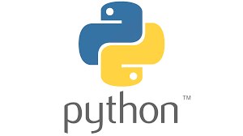



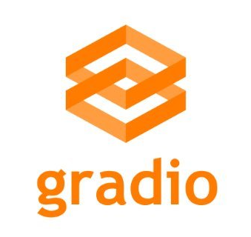

Tools and Libraries used

Slide 13
DEMO

Slide 14
Analysis of the two Chatbots

Slide 15
ChatBot Analysis
Category | Gemini Pro | ChatGPT-4 | Conclusion
Image Recognition | It was able to identity the same image repeatedly with confidence | It was able to recognize the same image and if given the same image again, it says it is not sure | Gemini performs much more in recognizing images accurately with confidence
Context retention | It tried as much to stay within context of the conversation even when we distract it intentionally, but it fails sometimes. | It also fails to maintain context sometimes and it diverts a few times. | Gemini sticks to the conversation context during the chat while ChatGPT can break within the chat.
Provision of related materials for additional knowledge | It was able to provide related links where necessary during the conversation to give tips to the User | It did not provide any external resource such as links to the User | Gemini gives related links and helpful tips. .

Slide 16
ChatBot Analysis
Category | Gemini Pro | ChatGPT-4 | Conclusion
Response Length | Its responses are generally lengthy but, well detailed and explanatory | Its responses are usually short and concise but can need more for in-depth conversations | Gemini gives a more useful answer to the end user.
Time taken to get User’s satisfaction | Gemini Pro took more time than usual to get to the end of the conversation due to the lengthy responses. | ChatGPT took a much shorter time to get to the end of the conversation | ChatGPT gets to the end of the conversation much faster
Relevance of response | Gemini’s responses are more relevant and practically thinkable to a newbie | ChatGPT gives a more advanced response that may require an IoT-experienced user to read and understand | Gemini gives more useful response to the context of the conversation

Slide 17
ChatBot Analysis
Category | Gemini Pro | ChatGPT-4 | Conclusion
Confidence in response | Gemini apologies even if the user falsely tells it that it has a wrong answer | ChatGPT apologies even if the user falsely tells it that it has a wrong answer | Both bots fail to stand their ground on their responses
Making inferences based on current conversation | Gemini gave an inference based on the general overview of the context of the chat, without considering the user’s responses | ChatGPT made an inference based on the conversation and a summary of the chat | ChatGPT was better at concluding the conversation to give a better recommendation.
Human-like responses | Gemini gives a more human friendly response | ChatGPT responses are direct and more robot-like | Gemini makes a better human mimic.

Slide 18
References
G“Gemini Versus ChatGPT: Applications, Performance, Architecture, Capabilities, and Implementation.” Nitin Rane, Saurabh Choudhary & Jayesh Rane. (2023) Available online: https://papers.ssrn.com/sol3/papers.cfm?abstract_id=4723687
“A Brief Analysis of “ChatGPT” – A Revolutionary Tool Designed by OpenAI Authors.” Md. Asraful Haque. (2023) Available online: https://publications.eai.eu/index.php/airo/article/view/2983
“Gemini technical report” https://storage.googleapis.com/deepmind media/gemini/gemini_1_report.pdf
Abukmeil, M., Ferrari, S., Genovese, A., Piuri, V., & Scotti, F. (2021). A survey of unsupervised generative models for exploratory data analysis and representation learning. Acm computing surveys (csur), 54(5), 1-40. https://doi.org/10.1145/3450963.

